Slide 1
Amplifying Organisational Intelligence
AI Solutions in Medicine
April 2019

Slide 2
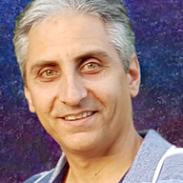
Amin Khatami
Senior Data Scientist
Honorary Affiliate at Deakin University
15+ years of Data Science and Mathematical Modelling
https://www.linkedin.com/in/amin-khatami/
PhD in Deep Learning, Computer Vision
B@Msc in Applied Mathematics, Stochastic Optimisation
PhD thesis: Deep Neural Network Generalisation in Small Datasets
Msc thesis: Neural Network Evalutionary Based Solutions for Dynamic Stochastic Optimisation: New Approach

Slide 3
Agenda
AI on the Healthcare Industry and Future Perspective
Deep Learning Framework Comparison
Use cases in Healthcare domain
Challenges
Segmentation, Classification, and Retrieval information
Robotics and Surgical Automation
Signal Processing and EEG
Image Search based on
Deep Features
Similarity Descriptive Features
Extend the proposed approach to general domain

Slide 4

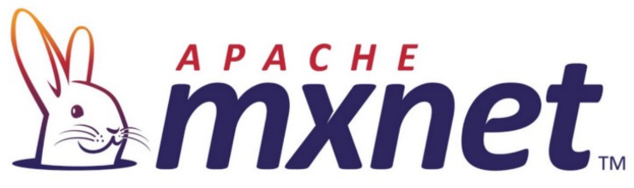
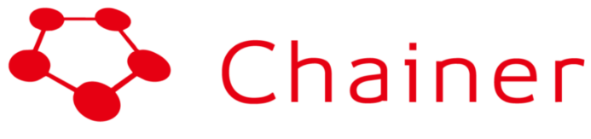




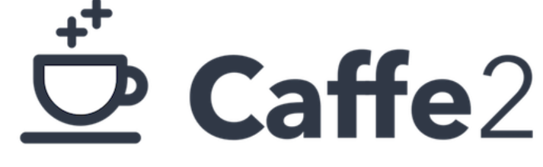
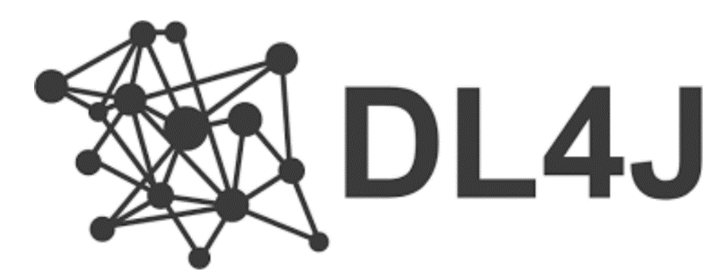

Deep Learning Frameworks Comparison
Notes:
There are so many dl frameworks already developed, but how are you supposed to know which one to use.
I am going to compare 10, across a widw variety of metrics, from populartity in github and job search, to speed and performance.
After reviewing pros and cons of these framework, I will have my own conclusion at the end.

Slide 5

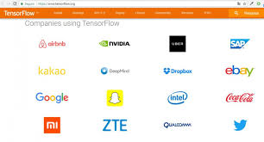

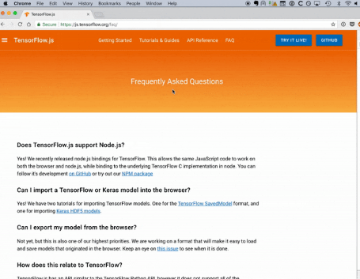




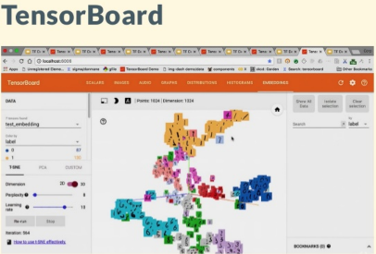
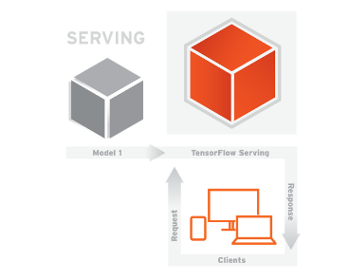

Deep Learning Frameworks Comparison
Companies decided using Tensor Flow
Best Client Language
Rich Docs
Platforms at Google using TF
TF Board
TF Serving
Notes:
Google created TF to help almost all of it’s massively scaled services like Gmail and translate
Nowadays recognizable companies such as User, Airband, and Dropbox are decided to leverage their platform by using TF
Currently, it‘s best supported client language is Python
Having massive developers community has resulted in TF having rich detail documents
This documentations cover its various features like tensor board and TF serving.
TF boar lets developers monitor the model training process via various visualizations
Another crucial part is TF serving allows developers to easily serve their models into a production environment
But despite all of this, TF is pretty low level

Slide 6

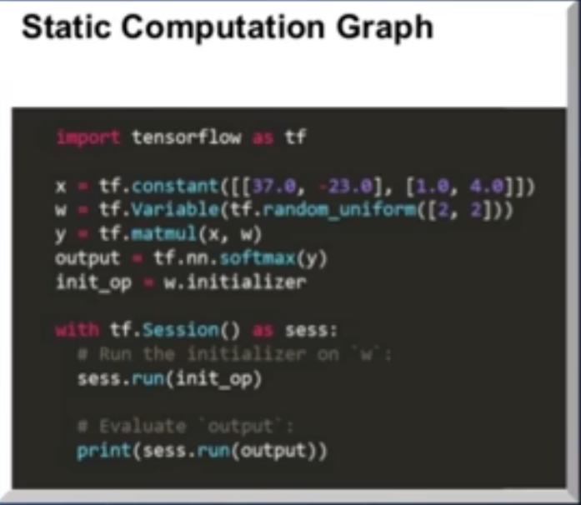
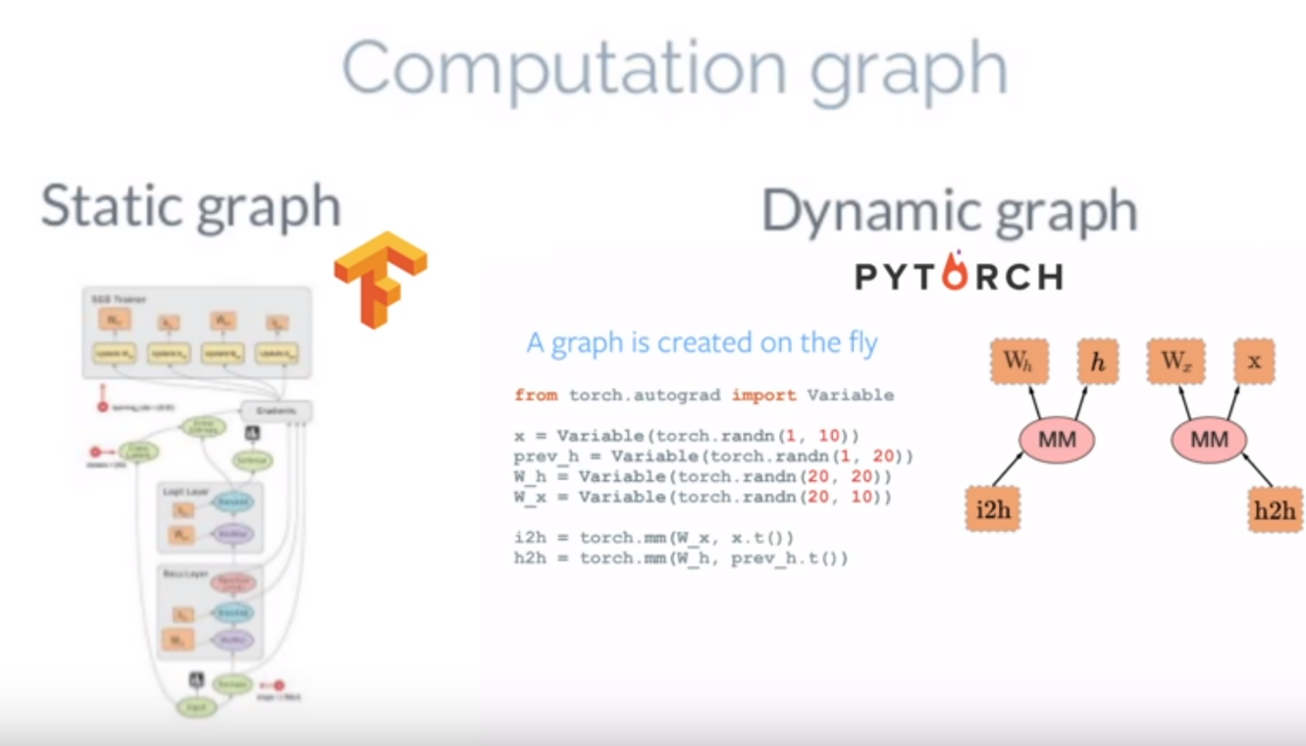
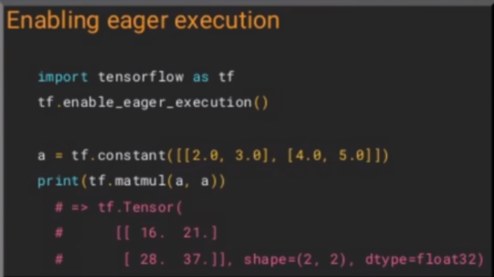


Deep Learning Frameworks Comparison
The Dark Side of TF
Static Graph (designed for efficiency):
Create graph at compile time
Define then Run
All conditions and iterations should be defined before run
Rebuild from scratch, If you want any changes
PyTorch: Default is by Run
In each Epoch, computational graph is created.
After each iteration, computational graph is freed (Available memory)
Graph is defined in a forward pass, so Backpropagation can be defined by how the code is run
Newer NN Architectures Dynamically change.
This makes debugging Difficult
Notes:
Having static computational graph is one of dark side from my side.

Slide 7

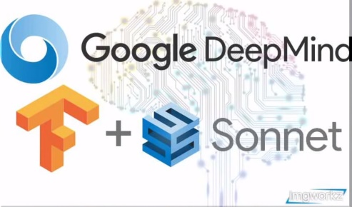

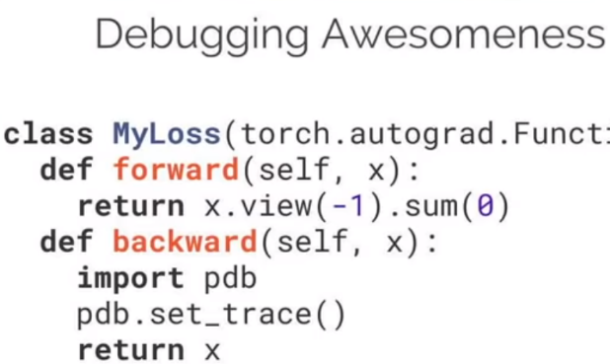

Deep Learning Frameworks Comparison
PyTorch:
Research
Prototyping
Small-scale Projects
DeepMind: The most prominent AI research lab does not use PyTorch
Sonnet: is built on the top of TF
Caffe2: Mobile and Large-scale deployment in production env
Dark Side:
Lacks interfaces for monitoring and visualization like TF Board
Creation of NN is easy:
Sonnet first Constructs Python Object (which rep some part of NN)
Then, separately connects these objects into the computational graph
This module simplify training process
Can be implemented in higher level
However, possibility to connect PyTorch to TF Board (TF Board X)
Lacks model serving, compared with TF
Notes:
Curiously, deepmind perhaps the most prominent AI research lab in the world does not use PyTorch. They use their own framework called Sonnet which is built on the top of TF

Slide 8
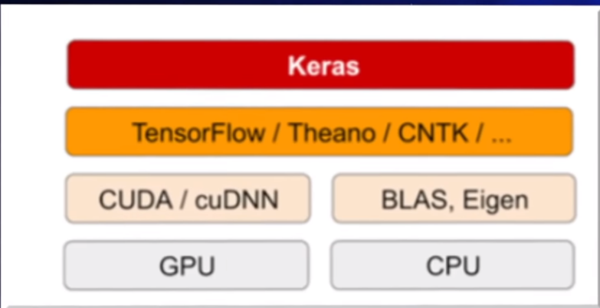



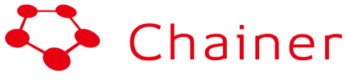
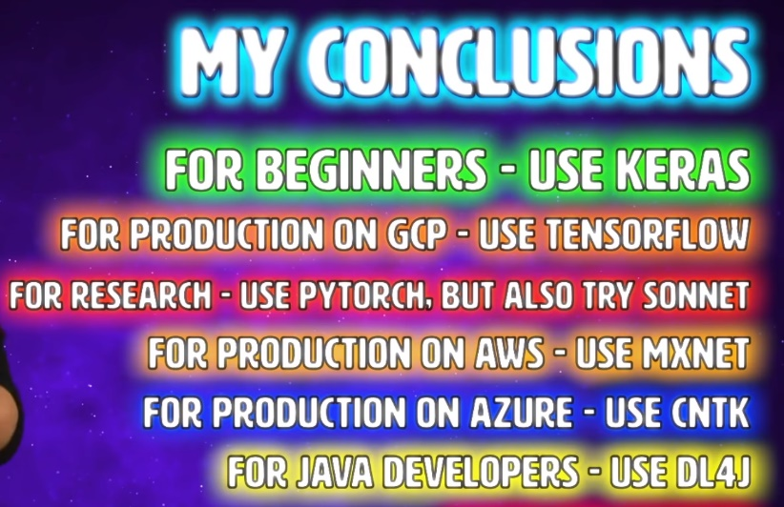
Deep Learning Frameworks Comparison
Famous as Scalability
NLP, speech, and forecasting
Quite fast
Many programming language, Python, R, Scala, JavaScript, C++, etc
For Beginners
Simple and easy code style
A few lines of code
Dark Side:
Much smaller community behind
Not popular for research
However it is good for big industry projects, since it is new, not receive support once needed
Training
Prototyping
Dark Side:
High level programming
Not easy to customize
Constrained to TF, Theano, CNTK
Less functionality than low level

Slide 9
AI & Robotics in Medical Practices
Use cases in Healthcare domain
Challenges
Segmentation, Classification, and Retrieval information
Robotics and Surgical Automation
Signal Processing and EEG
Notes:
Before driving into more details, I have one question. What is the future of data science? Do you believe big companies like google, deepmind, and nvidia are creating this future? Some primary tasks in computer vision, NLP, signal processing and autonomous tasks are developing promising future works.
We have the same in healthcare domain, but there are some challenges which make the work very difficult.

Slide 10
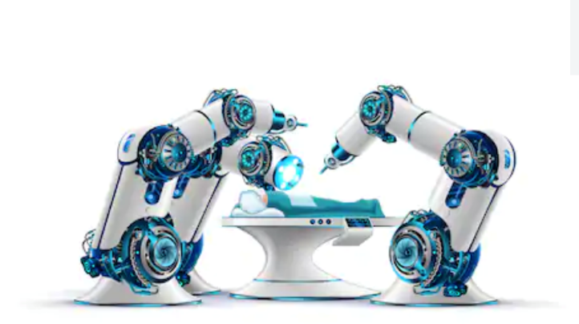
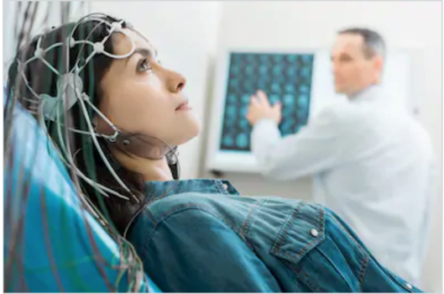
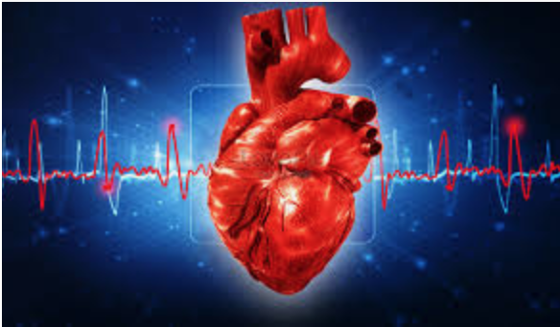
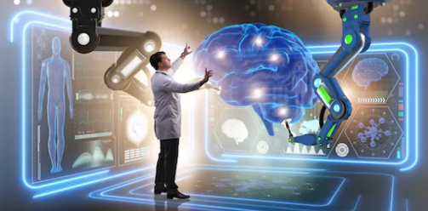
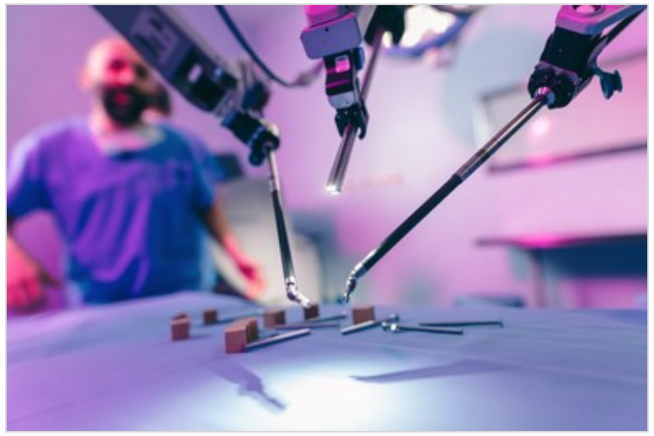
Use cases in Healthcare domain
Medical Imagery
Robotic surgery
Biomedical Applications
Medical Imaging
Disease Recognition
Discover Anomalous Patterns
Content-based Medical Image Retrieval
Signal Processing
Medical Haptics Feedbacks
Surgical Robots and Tactile Understanding
Signal Processing
Electroencephalogram (EEG)
Genomic Medicine
Notes:
There are some use cases I’ve developed and I want to highlight today, which mostly focusing on Detection patterns and diagnosis.
Also, I want to talk a little bit about how we can built an autonomous system in medicine. But, before that one, lets see the challenges

Slide 11
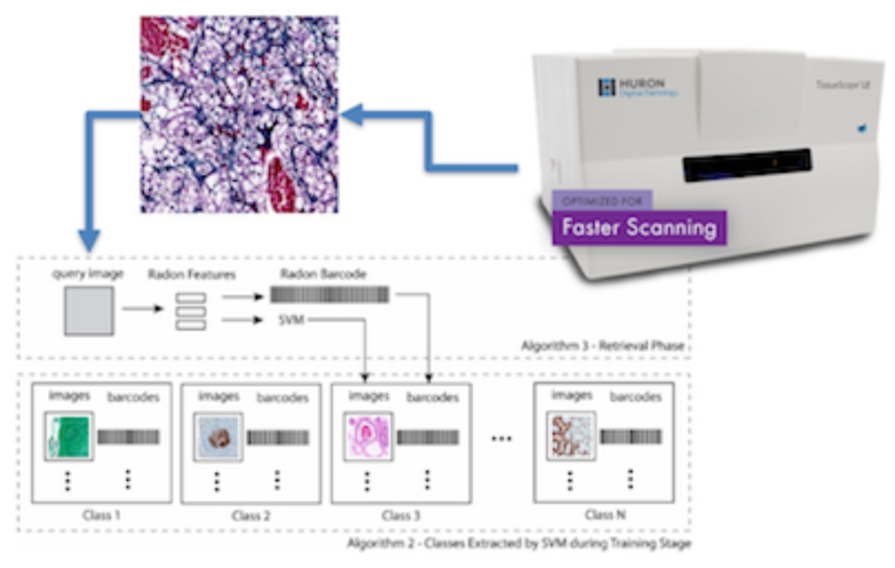

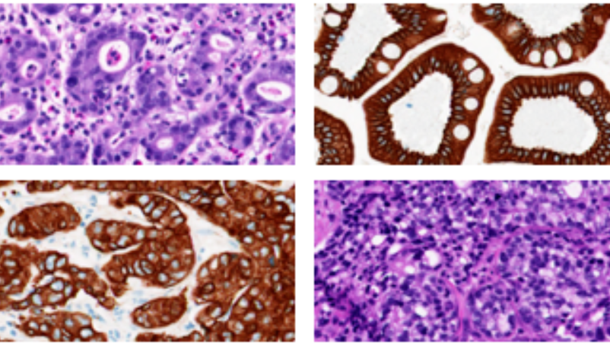
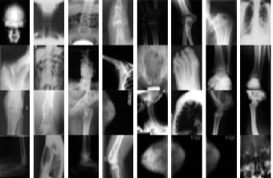
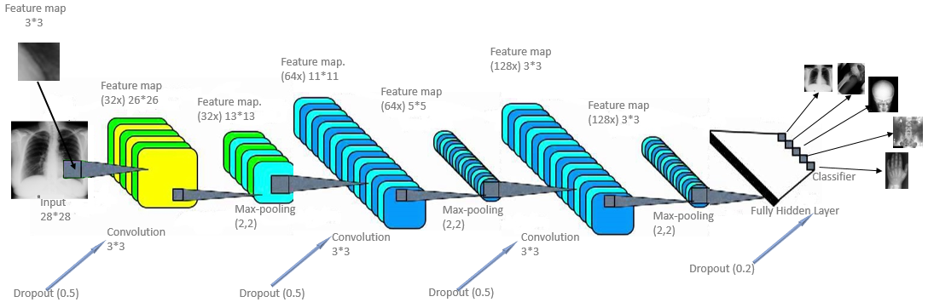
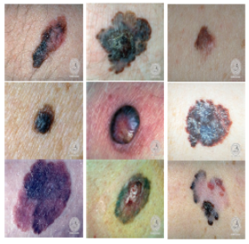
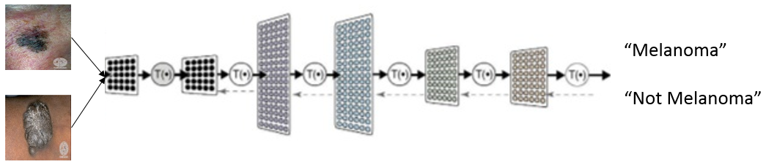
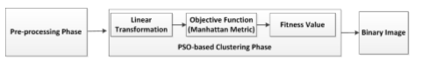
Automatic classification systems & X-ray Image Retrieval
Challenges:
"suffering" from BigData.
Unlabeled Data
Large physical archives
Need to be converted to digital pathology
Need specialists to validate in each stage
Difficult to Convince
So,
Recommendation systems:
on Time Series Forecasting
on Image Search
on Abstract Docs
Convolutional Neural Network
Solutions:
Many solutions based on classification, and segmentation
Colour-shape based foreground object detection
Acquiring an image from the specimen enables more systematic analysis, collaborations possibilities and, last but not least, the computer-aided diagnosis for pathology, arguable the final frontier of vision-based disease diagnosis.
Health care Atlas automation
Colour Space to segment ROI detection
Notes:
KIMIA lab is one of the biggest Medical lab developing AI solutions in Healthcare domain in Canada. The lab has done very fantastic works in medicine by using insight from medical imaging data. Currently, they are developing a comprehensive framework with Huron company, meaning having exclusive pathology IP in whole Canada. They are very close and having joint works with big teams in Canada, handelling by Jrfree Hinthon and Vector company.
I’ve done some works therein segmentation and classification domains.
Here are some of my experience there.

Slide 12
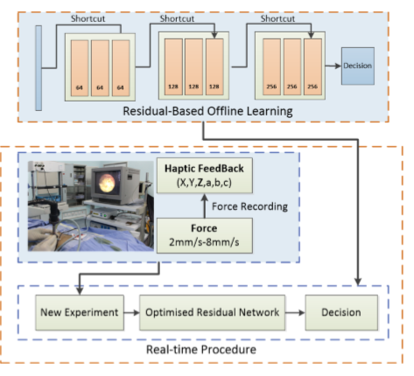
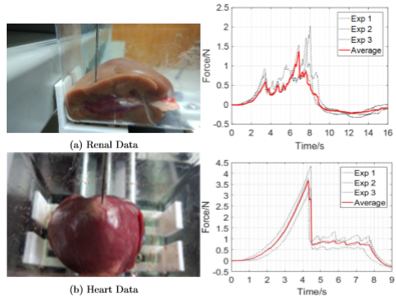
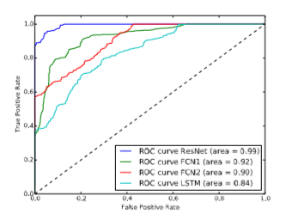
Surgical Robot and Haptics
The aim? To push surgical robot one step ahead and further
A Deep Learning-Based Model For Tactile Understanding on Haptic Data Percutaneous Needle Treatment
Tactile understanding during surgery is essential in medical simulation.
The importance is emphasised when problems such as a delay is occurring during simulation.
Monitoring, predicting, and understanding the sense of tissue which is supposed to be involved in operation is vital during surgery
What we want to solve here? We want to teach robot to feel similar human.
Notes:
Let’s have a look on another use case using ML to create autonomous tasks. To be honest, I did not want to include this slide today, but changed the mind and think it’s worth to mention.
The aim? To push surgical robot one step ahead and further
What we want to solve here? We want to teach robot to feel similar human.
The Data for tackstile?
The devices
What is haptics? It is a device looks like a joystick. When you are moving this device, the surgical robot that is far away of the device is moving, at the same time, you are receiving a feedback signal, which is a sense of how soft or hard that organ is.
This work that has been done with the operations in a Chinese hospital, we created tacktile understanding framework happening during needle treatment.

Slide 13
Image Search in Healthcare domain
Deep Features
Traditional descriptors
Our approach and analysis

Slide 14
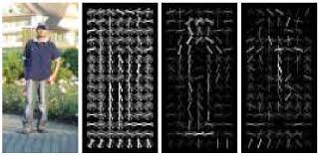
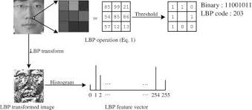
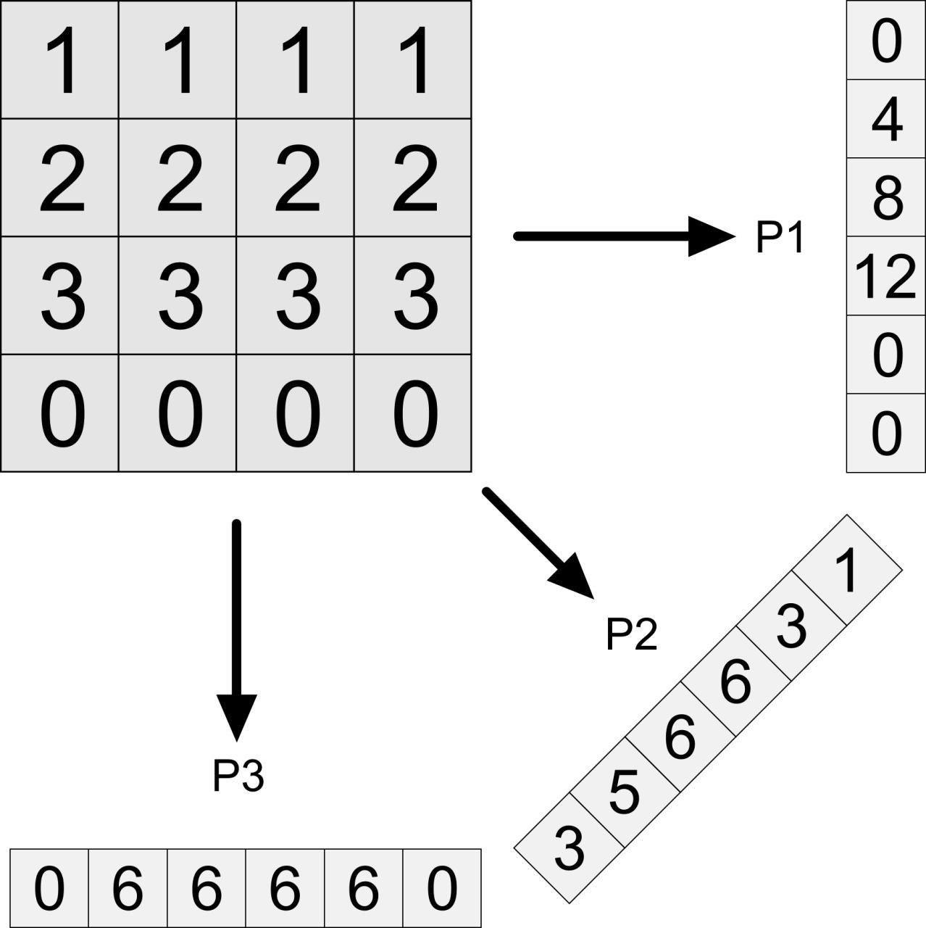
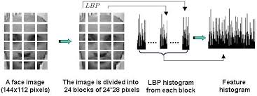
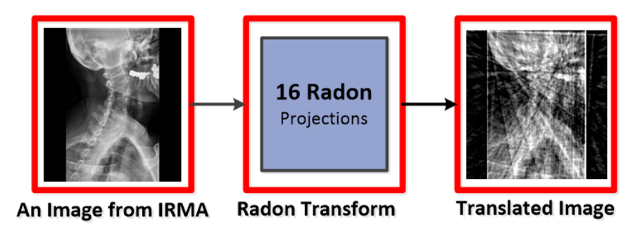
Image Search
HOG:
Deep learning is promising in general domain having:
Visual Big data such as ImageNet
Text Big data in twitter
Dense signal data Spectral density
Time series
Traditional Descriptors:
LBP:
Radon:
Accurate features are captures by deep networks in cased of having Big Data
Need help from traditional approaches to capture right features in small datasets
Notes:
The aim? Develop similar-based features
Image search is one of applicable big projrct that can be defined with hospitals
Local binary patterns
We are using these there techniques to enhance deep features

Slide 15
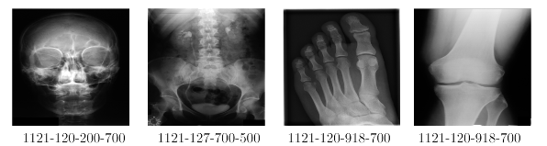
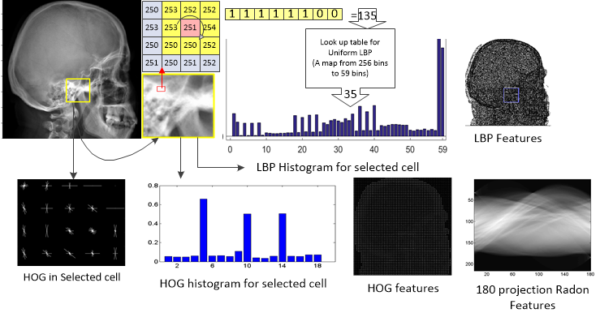
Automatic classification systems & X-ray Image Retrieval
Our Approaches, computer-aided diagnosis techniques
Unsupervised and Supervised Techniques
Combination of Deep Learning and traditional ML
Content-Based Image Retrieval and BARCODE
Binary Tags for Big Image Data

Slide 16
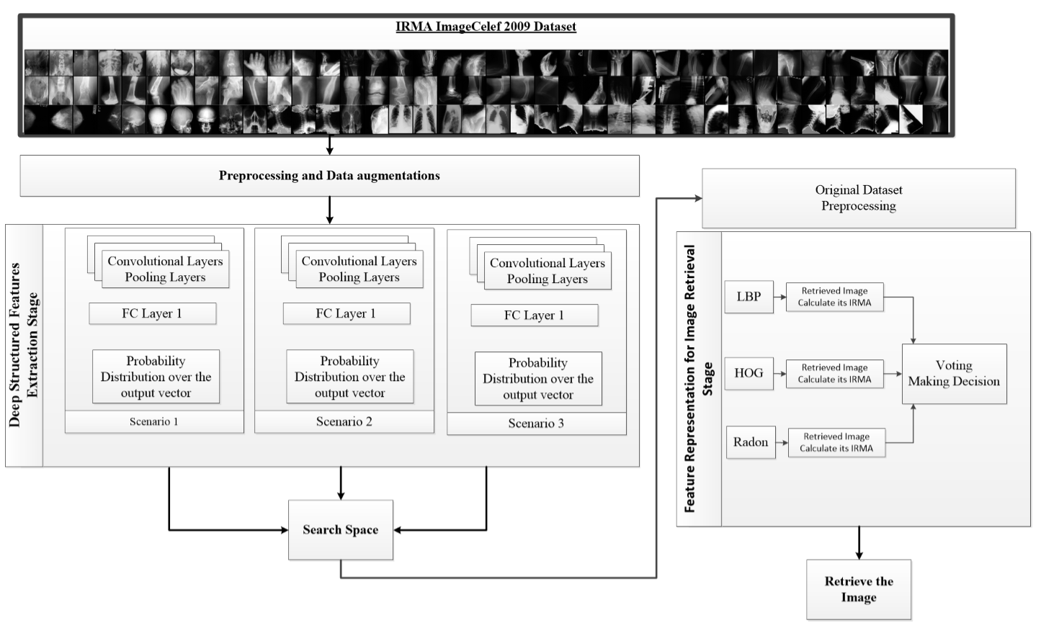
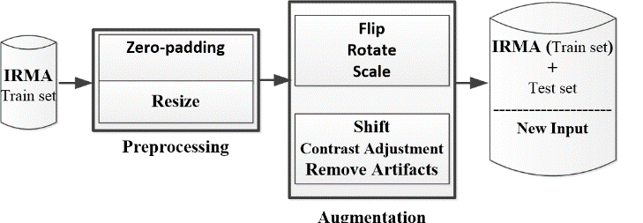
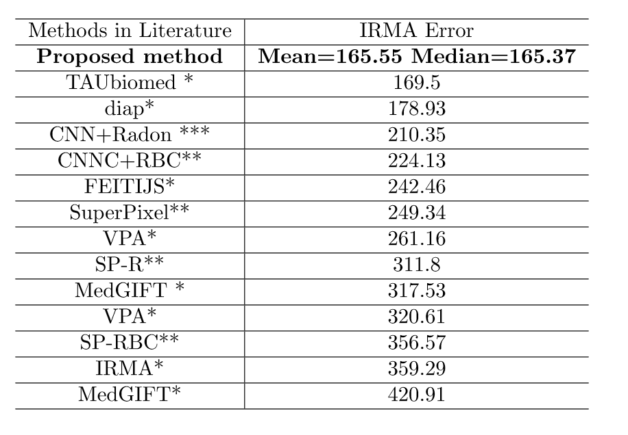
Image Search
Different distributions on the same dataset

Slide 17
References
Deep Learning Frameworks, Siraj, https://www.youtube.com/watch?v=SJldOOs4vB8
A. Khatami, A. Khosravi, T. Nguyen, C.P. Lim, S.Nahavandi, ”Data Analysis Using Wavelet Transform and Deep Belief Networks”, Journal of Expert System with Applications, 190-198, 2017, Elsevier.
A. Khatami, A. Khosravi, S. Nahavandi, H.R. Tizhoosh, ”Parallel Deep Solutions for Data Retrieval from Imbalanced Archives”, Journal of Applied Soft Computing, 2017, Elsevier
A. Khatami, M. Babaei, H.R. Tizhoosh, A. Khosravi, S. Nahavandi, ”A Sequential Search-Space Shrinking Using CNN Transfer Learning and a Radon Projection Pool for Data Retrieval”, Journal of Expert System with Application, 2018
A. Khatami, M. Babaei, H.R. Tizhoosh, A. Khosravi, S. Nahavandi, ”A Radon-Based Convolutional Neural Network for Medical Image Retrieval ”, International Journal of Engineering, 2018.
M. Babaie, A. Khatami, Sh. Rahnamayan, Classiﬁcation and Retrieval of Digital Pathology Scans: A New Dataset, CVPR, 2017.
A. Khatami, A. Khosravi, H.R. Tizhoosh, S. Nahavandi, A deep-structural Image Classiﬁcation for a Radon-based Data Retrieval, IEEE CCECE, 2017, IEEE.
A. Khatami, Y. Tai, A. Khosravi, L. Wei, S. Nahavandi, A Deep-Based Model For Tactile Understanding on Data Percutaneous Needle Treatment, ICONIP, 2017.
A. Khatami, S. Mirghasemi, A. Khosravi, C.P. Lim, S. Nahavandi, A Swarm Optimization-based Kmedoids Clustering Technique for Extracting Colour Features from Melanoma Skin Cancer Images, ICONIP, 2017
A. Khatami, Y. Tai, A. Khosravi, L. Wei, S. Nahavandi, A Haptics Feedback Based-LSTM Predictive Model for Pericardiocentesis Therapy, ICONIP, 2017.

